Slide 1


Slide 2
Chapter 11
Just-in-Time and Lean Systems

Slide 3
OBJECTIVES
JIT Defined
The Toyota Production System
JIT Implementation Requirements
JIT in Services
Notes:
2

Slide 4
Just-In-Time (JIT)
Defined
JIT can be defined as an integrated set of activities designed to achieve high-volume production using minimal inventories (raw materials, work in process, and finished goods)
JIT also involves the elimination of waste in production effort
JIT also involves the timing of production resources (i.e., parts arrive at the next workstation “just in time”)
Notes:
3

Slide 5
JIT and Lean Management
JIT can be divided into two terms: “Big JIT” and “Little JIT”
Big JIT (also called Lean Management) is a philosophy of operations management that seeks to eliminate waste in all aspects of a firm’s production activities: human relations, vendor relations, technology, and the management of materials and inventory
Little JIT focuses more narrowly on scheduling goods inventory and providing service resources where and when needed
Notes:
3

Slide 6
JIT Demand-Pull Logic
Here the customer starts the process, pulling an inventory item from Final Assembly…
Then sub-assembly work is pulled forward by that demand…
Fab
Vendor
Sub
Fab
Vendor
Final
Assembly
Customers
The process continues throughout the entire production process and supply chain
Sub
Fab
Vendor
Fab
Vendor
Notes:
4

Slide 7

The Toyota Production System
Based on two philosophies:
1. Elimination of waste
2. Respect for people
Notes:
5

Slide 8
Waste in Operations
Waste from overproduction
Waste of waiting time
Transportation waste
Inventory waste
Processing waste
Waste of motion
Waste from product defects
Notes:
6

Slide 9
Minimizing Waste:
Focused Factory
Networks
These are small specialized plants that limit the range of products produced (sometimes only one type of product for an entire facility)
Some plants in Japan have as few as 30 and as many as 1000 employees
Coordination
System Integration
Notes:
7

Slide 10
Minimizing Waste: Group Technology (Part 1)
Note how the flow lines are going back and forth
Using Departmental Specialization for plant layout can cause a lot of unnecessary material movement
Saw
Saw
Saw
Grinder
Grinder
Heat Treat
Lathe
Lathe
Lathe
Press
Press
Press
Notes:
8

Slide 11
Minimizing Waste:
Group Technology (Part 2)
Revising by using Group Technology Cells can reduce movement and improve product flow
Grinder
1
2
Saw
Lathe
Lathe
Press
Heat Treat
Grinder
Saw
Lathe
A
B
Lathe
Press
Notes:
9

Slide 12
Minimizing Waste:
Uniform Plant Loading (heijunka)
Suppose we operate a production plant that produces a single product. The schedule of production for this product could be accomplished using either of the two plant loading schedules below.
Not uniform Jan. Units Feb. Units Mar. Units Total
1,200 3,500 4,300 9,000
or
Uniform Jan. Units Feb. Units Mar. Units Total
3,000 3,000 3,000 9,000
How does the uniform loading help save labor costs?
Notes:
12

Slide 13
Minimizing Waste: Just-In-Time Production
Management philosophy
“Pull” system though the plant
WHAT IT IS
Attacks waste
Exposes problems and bottlenecks
Achieves streamlined production
WHAT IT DOES
Stable environment
Employee participation
Industrial engineering/basics
Continuing improvement
Total quality control
Small lot sizes
WHAT IT ASSUMES
WHAT IT REQUIRES
Notes:
13

Slide 14
Minimizing Waste: Inventory
Hides Problems
Example: By identifying defective items from a vendor early in the production process the downstream work is saved
Machine
downtime
Scrap
Vendor
Work in
delinquencies
Change
process
orders
queues
Engineering design
Design
(banks)
redundancies
backlogs
Example: By identifying defective work by employees upstream, the downstream work is saved
Paperwork
Inspection
Decision
backlog
backlogs
backlogs
Notes:
14

Slide 15
Minimizing Waste: Kanban Production Control Systems
This puts the system back were it was before the item was pulled
Once the Production kanban is received, the Machine Center produces a unit to replace the one taken by the Assembly Line people in the first place
Withdrawal
kanban
Storage Part A
Storage Part A
Machine Center
Assembly Line
Production kanban
Material Flow
Card (signal) Flow
The process begins by the Assembly Line people pulling Part A from Storage
Notes:
15

Slide 16
Determining the Number of Kanbans Needed
Setting up a kanban system requires determining the number of kanbans cards (or containers) needed
Each container represents the minimum production lot size
An accurate estimate of the lead time required to produce a container is key to determining how many kanbans are required
Notes:
16

Slide 17
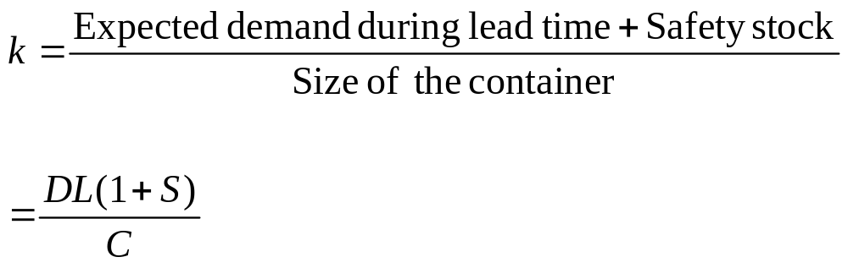
The Number of Kanban Card Sets
k = Number of kanban card sets (a set is a card)
D = Average number of units demanded over some time period
L = lead time to replenish an order (same units of time as demand)
S = Safety stock expressed as a percentage of demand during leadtime
C = Container size
Notes:
17

Slide 18
Example of Kanban Card Determination: Problem Data
A switch assembly is assembled in batches of 4 units from an “upstream” assembly area and delivered in a special container to a “downstream” control-panel assembly operation
The control-panel assembly area requires 5 switch assemblies per hour
The switch assembly area can produce a container of switch assemblies in 2 hours
Safety stock has been set at 10% of needed inventory
Notes:
18

Slide 19
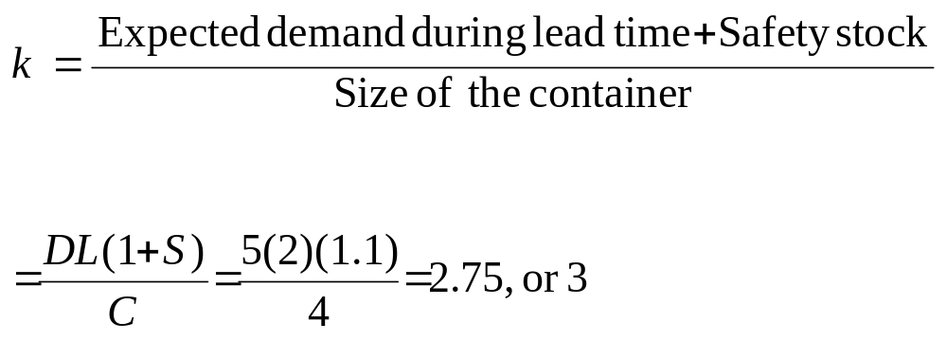
Example of Kanban Card Determination: Calculations
Always round up!
Notes:
19

Slide 20
Respect for People
Level payrolls
Cooperative employee unions
Subcontractor networks
Bottom-round management style
Quality circles (Small Group Involvement Activities or SGIA’s)
Notes:
21

Slide 21
Toyota Production System’s Four Rules
All work shall be highly specified as to content, sequence, timing, and outcome
Every customer-supplier connection must be direct, and there must be an unambiguous yes-or-no way to send requests and receive responses
The pathway for every product and service must be simple and direct
Any improvement must be made in accordance with the scientific method, under the guidance of a teacher, at the lowest possible level in the organization
Notes:
21

Slide 22
JIT Implementation Requirements: Design Flow Process
Link operations
Balance workstation capacities
Redesign layout for flow
Emphasize preventive maintenance
Reduce lot sizes
Reduce setup/changeover time
Notes:
23

Slide 23
JIT Implementation Requirements: Total Quality Control
Worker responsibility
Measure SQC
Enforce compliance
Fail-safe methods
Automatic inspection
Notes:
24

Slide 24
JIT Implementation Requirements: Stabilize Schedule
Level schedule
Underutilize capacity
Establish freeze windows
Notes:
25

Slide 25
JIT Implementation Requirements: Kanban-Pull
Demand pull
Backflush
Reduce lot sizes
Notes:
26

Slide 26
JIT Implementation Requirements: Work with Vendors
Reduce lead times
Frequent deliveries
Project usage requirements
Quality expectations
Notes:
27

Slide 27
JIT Implementation Requirements: Reduce Inventory More
Look for other areas
Stores
Transit
Carousels
Conveyors
Notes:
28

Slide 28
JIT Implementation Requirements: Improve Product Design
Standard product configuration
Standardize and reduce number of parts
Process design with product design
Quality expectations
Notes:
29

Slide 29
JIT Implementation Requirements: Concurrently Solve Problems
Root cause
Solve permanently
Team approach
Line and specialist responsibility
Continual education
Notes:
29

Slide 30
JIT Implementation Requirements: Measure Performance
Emphasize improvement
Track trends
Notes:
29

Slide 31
JIT in Services (Examples)
Organize Problem-Solving Groups
Upgrade Housekeeping
Upgrade Quality
Clarify Process Flows
Revise Equipment and Process Technologies
Notes:
30

Slide 32
JIT in Services (Examples)
Level the Facility Load
Eliminate Unnecessary Activities
Reorganize Physical Configuration
Introduce Demand-Pull Scheduling
Develop Supplier Networks
Notes:
31

Slide 33
End of Chapter 11

